Slide 1
Progress on understanding Principal Component Analysis(PCA)
By: Steven Cao

Slide 2
What is PCA? (Principal Component Analysis)
Principal component analysis (PCA) is a procedure for reducing the dimensionality of the variable space by representing it with a few uncorrelated variables that capture most of its variability.
This variable space is most of the time greater than 2. In my case, it is 187 features, so a 187-dimensional variable space.
PCA is a variance maximizing exercise.
Show DATA that you reduced the variable space.
Conclusion: We know what is PCA.

Slide 3
How does PCA do its job of reducing the dimensionality of the variable space?
Feature Elimination: Eliminating features to reduce the feature space. Information is almost not lost; however, due to dropped features.
Feature Extraction: In feature extraction, we create “new” independent variables, where each independent variable is a combination of each of the given old independent variables.
Conclusion: We see that there are two ways to reduce the dimensionality of the variable space

Slide 4

What is the first thing you need to do in order to do PCA?
Standardization: Calculate the mean of all the dimensions of the dataset, except the labels. Scale the data so that each variable contributes equally to analysis. In the equation given below, z is the scaled value, x is the initial, and mu and sigma are mean and standard deviation, respectively.
Conclusion: We see that you have to first standardize the dataset first to do PCA

Slide 5
Why is it important to standardize the dataset first before doing PCA?
PCA is sensitive regarding the variances of the initial variables. If you do not standardize the x dataset before PCA, then some variables that have huge numbers may have more weight that others.
Conclusion: We want the variables to have the same weights.

Slide 6
If you did not standardize the dataset, but got a better explained_ratio, should you not normalize the dataset?
Standardizing the data allows PCA to calculate the relevant axises.
If you do not standardize the dataset, then some variables which are not important, but have huge numbers will have huge variance , which will cause PCA to use those unimportant features.
Conclusion: It seems that it depends on the data.

Slide 7
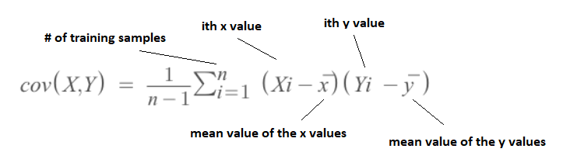
What is the second step in doing PCA?
Compute the Covariance Matrix
Below is the equation for computing the covariance of two variables, x and y.
N-dimensional data will result in a N * N covariance matrix
Variance – measure of the deviation from the mean for points in one dimension (cannot be negative)
Covariance -- measure of how much each of the dimensions vary from the mean with respect to each other.
Covariance evaluates how the mean values of two variables move together.
The covariance between one dimension and itself is the variance
Conclusion: We now know what is the second step of PCA

Slide 8
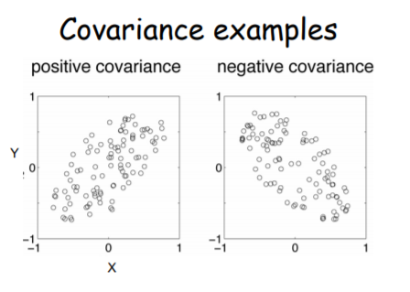
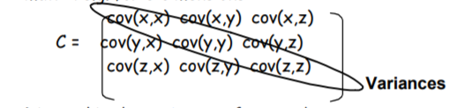
What does the covariance matrix tell you
What does the covariance matrix tell you?
These values in the covariance matrix show the distribution magnitude and direction of multivariate data in multidimensional space. By controlling these values we can have information about how data spread among two dimensions.
What does it mean if we have positive , negative, or zero covariance between two dimensions?
A positive value of covariance indicates both dimensions increase or decrease together e.g. as the number of hours studied increases, the marks in that subject increase.
A negative value indicates while one increases the other decreases, or vice-versa.
If covariance is zero: the two dimensions are independent of each other

Slide 9
Why do we use the covariance matrix?
Why do we use the covariance matrix in PCA?
The covariance matrix provide an estimate of the variance in individual random variables and also measure whether variables are correlated.
PCA is a variance maximizing exercise.
Conclusion: We need to use the covariance to get the variance of each variable, to get the principal components with the most amount of variance

Slide 10

What is the 3rd step of doing PCA?
Compute Eigenvectors and corresponding Eigenvalues on the covariance matrix

Slide 11
Questions
Can you do PCA on a 2D variable space? Is it helpful at all?
Is it important that the principal components resulted from PCA are uncorrelated? If so, why?

